Slide 1

QML Live-Coding for Everyone

Slide 2
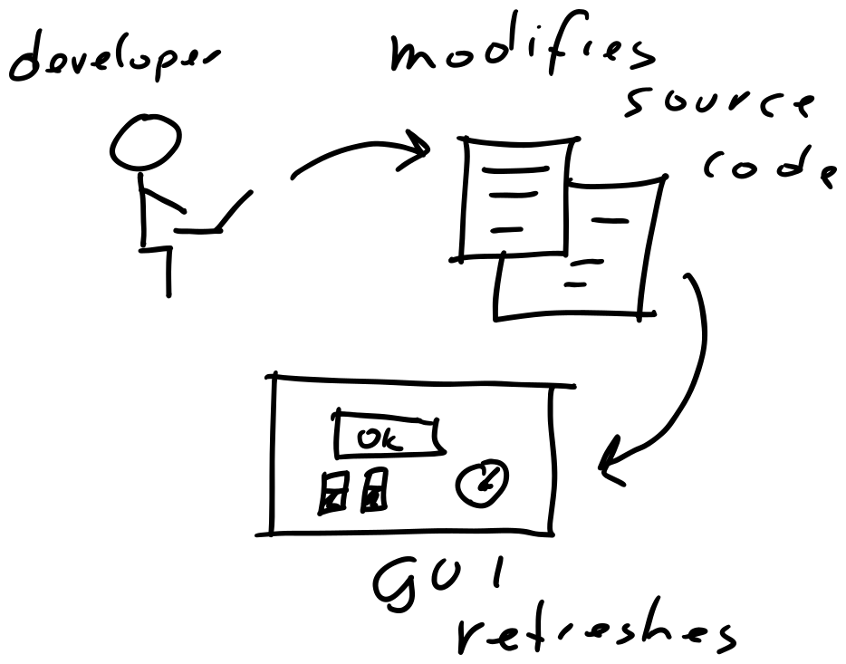
Live-Coding
Automatic reloading
Short feedback loops

Slide 3
Demo Time!

Slide 4

More Information
https://machinekoder.com
https://github.com/machinekoder/cpp-qt-live-coding
https://github.com/machinekoder/python-qt-live-coding
Questions ?

